Slide 1
AVL Trees
Initially prepared by Dr. İlyas Çiçekli; improved by various Bilkent CS202 instructors.

Slide 2
Balanced Search Trees
The height of a binary search tree is sensitive to the order of insertions and deletions.
The height of a binary search tree is between ⎡ log₂(N+1) ⎤ and N.
So, the worst case behavior of some BST operations are O(N).
There are various search trees that can retain their balance at the end of each insertion and deletion.
AVL Trees
2-3 Trees
2-3-4 Trees
Red-Black Trees
In these height balanced search trees, the run time complexity of insertion, deletion, and retrieval operations is O(log₂N) at the worst case.

Slide 3
AVL Trees
An AVL tree is a binary search tree with a balance condition.
AVL is named for its inventors: Adel’son-Vel’skii and Landis
AVL tree approximates the ideal tree (completely balanced tree).
AVL Tree maintains a height close to the minimum.

Slide 4
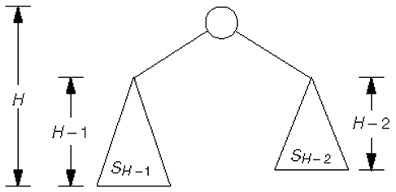
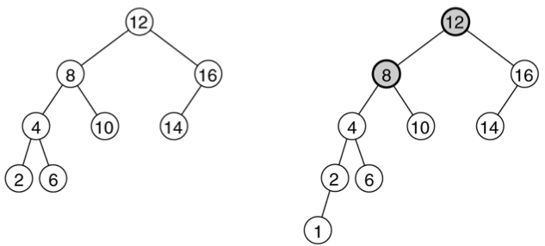
AVL Trees
Definition:
An AVL tree is a binary search tree such that for any node in the tree, the height of the left and right subtrees can differ by at most 1.
An AVL tree
NOT an AVL tree
(unbalanced nodes are darkened)

Slide 5
AVL Trees -- Properties
The depth of a typical node in an AVL tree is very close to the optimal log₂N.
Consequently, all searching operations in an AVL tree have logarithmic worst-case bounds.
An update (insert or delete) in an AVL tree could destroy the balance.
➔ It must then be rebalanced before the operation can be
considered complete.

Slide 6
AVL Tree -- Insertions
Insert is the same as Binary Search Tree insertion
Then, starting from the insertion point, check for balance at each node
It is enough to perform correction “rotation” only at the first node where imbalance occurs
On the path from the inserted node to the root.

Slide 7
AVL -- Insertions
An AVL violation might occur in four possible cases:
Insertion into left subtree of left child of node n
Insertion into right subtree of left child of node n
Insertion into left subtree of right child of node n
Insertion into right subtree of right child of node n
(1) and (4) are mirror cases
(2) and (3) are mirror cases
If insertion occurs “outside” (1 & 4), then perform single rotation.
If insertion occurs “inside” (2 & 3), then perform double rotation.

Slide 8
AVL Trees -- Balance Operations
Balance is restored by tree rotations.
There are four different cases for rotations:
Single Right Rotation
Single Left Rotation
Double Right-Left Rotation
Double Left-Right Rotation

Slide 9
AVL Trees -- Single Rotation
A single rotation switches the roles of the parent and the child while maintaining the search order.
We rotate between a node and its child (left or right).
Child becomes parent
Parent becomes right child in Case 1 (single right rotation)
Parent becomes left child in Case 2 (single left rotation)
The result is a binary search tree that satisfies the AVL property.

Slide 10
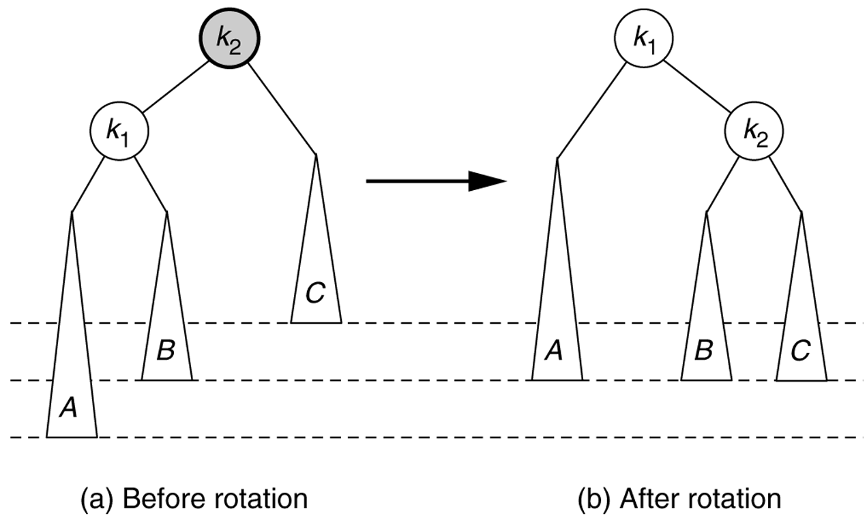
Case 1 -- Single Right Rotation
Child becomes parent
Parent becomes right child

Slide 11
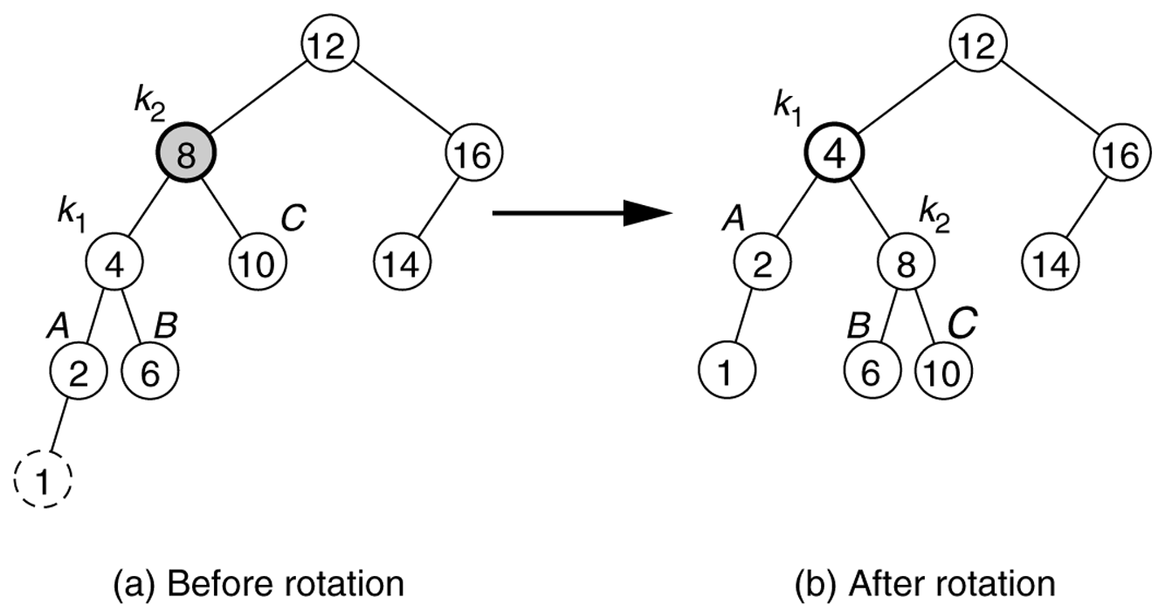
Case 1 -- Single Right Rotation
Child becomes parent
Parent becomes right child

Slide 12

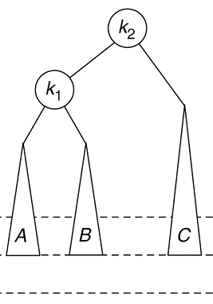
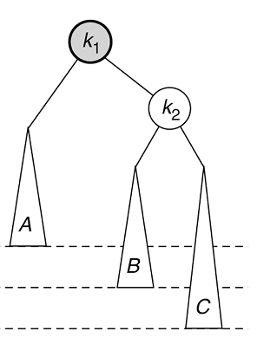
Case 2 – Single Left Rotation
Before Rotation
After Rotation
Child becomes parent
Parent becomes left child

Slide 13
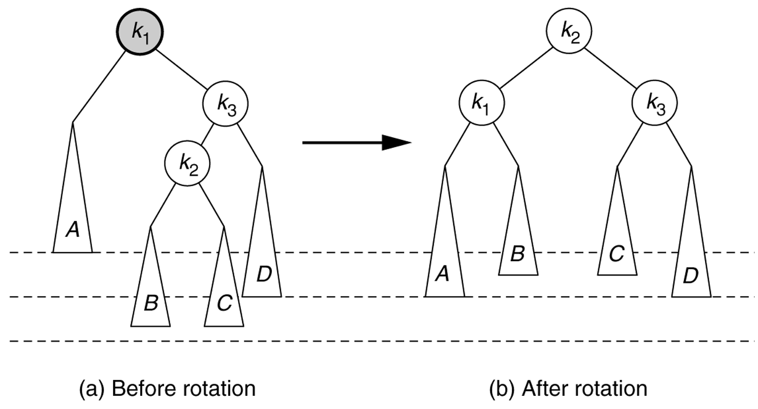
Case 3 -- Double Right-Left Rotation
The height of B (or C) is the same as the height of D
First perform single right rotation on k2 and k3
Then perform single left rotation on k2 and k1

Slide 14
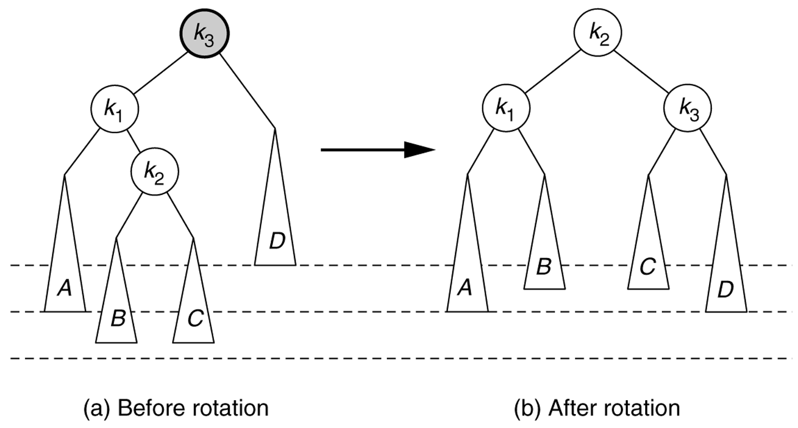
Case 4 -- Double Left-Right Rotation
The height of B (or C) is the same as the height of A
First perform single left rotation on k2 and k1
Then perform single right rotation on k2 and k3

Slide 15
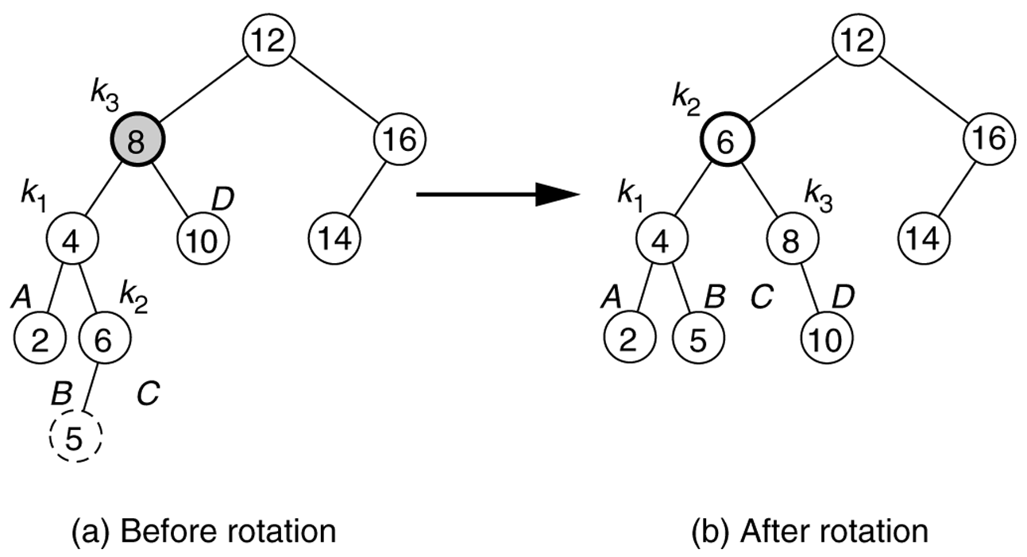
Case 4 -- Double Left-Right Rotation
First perform single left rotation on k2 and k1
Then perform single right rotation on k2 and k3

Slide 16
AVL Trees -- Insertion
It is enough to perform rotation only at the first node
Where imbalance occurs
On the path from the inserted node to the root.
The rotation takes O(1) time.
After insertion, only nodes that are on the path from the insertion point to the root can have their balances changed.
Hence insertion is O(logN)

Slide 17
AVL Trees -- Insertion
Exercise: Starting with an empty AVL tree, insert the following items
7 6 5 4 3 2 1 8 9 10 11 12
Check the following applet for more exercises.
http://www.site.uottawa.ca/~stan/csi2514/applets/avl/BT.html

Slide 18
AVL Trees -- Deletion
Deletion is more complicated.
It requires both single and double rotations
We may need more than one rebalance operation (rotation) on the path from the deleted node back to the root.
Steps:
First delete the node the same as deleting it from a binary search tree
Remember that a node can be either a leaf node or a node with a single child or a node with two children
Walk through from the deleted node back to the root and rebalance the nodes on the path if required
Since a rotation can change the height of the original tree
Deletion is O(logN)
Each rotation takes O(1) time
We may have at most h (height) rotations, where h = O(logN)

Slide 19
AVL Trees -- Deletion
For the implementation
We have a shorter flag that shows if a subtree has been shortened
Each node is associated with a balance factor
left-high the height of the left subtree is higher than that of the right subtree
right-high the height of the right subtree is higher than that of the left subtree
equal the height of the left and right subtrees is equal
In the deletion algorithm
Shorter is initialized as true
Starting from the deleted node back to the root, take an action depending on
The value of shorter
The balance factor of the current node
Sometimes the balance factor of a child of the current node
Until shorter becomes false

Slide 20
AVL Trees -- Deletion
Three cases according to the balance factor of the current node
The balance factor is equal
➔ no rotation
The balance factor is not equal and the taller subtree was shortened
➔ no rotation
The balance factor is not equal and the shorter subtree was shortened
➔ rotation is necessary

Slide 21
AVL Trees -- Deletion
Case 1: The balance factor of p is equal.
Change the balance factor of p to right-high (or left-high)
Shorter becomes false
–
p
\
p
No rotations
Height unchanged
T₁
T₂
T₁
T₂
deleted

Slide 22
AVL Trees -- Deletion
Case 2: The balance factor of p is not equal and the taller subtree is shortened.
Change the balance factor of p to equal
Shorter remains true
/
p
–
p
No rotations
Height reduced
T₁
T₂
T₁
T₂
deleted

Slide 23
AVL Trees -- Deletion
Case 3: The balance factor of p is not equal and the shorter subtree is shortened.
Rotation is necessary
Let q be the root of the taller subtree of p
We have three sub-cases according to the balance factor of q

Slide 24
AVL Trees -- Deletion
Case 3a: The balance factor of q is equal.
Apply a single rotation
Change the balance factor of q to left-high (or right-high)
Shorter becomes false
p
/
q
\
–
q
p
\
h-1
T₁
h
T₃
h
T₂
h
T₃
deleted
h-1
T₁
T₂
h
Single rotation
Height unchanged

Slide 25
AVL Trees -- Deletion
Case 3b: The balance factor of q is the same as that of p.
Apply a single rotation
Change the balance factors of p and q to equal
Shorter remains true
p
–
q
\
\
q
–
p
h-1
T₁
h
T₃
h-1
h-1
T₂
T₃
h-1
T₁
T₂
h
deleted
Single rotation
Height reduced

Slide 26
AVL Trees -- Deletion
Case 3c: The balance factor of q is the opposite of that of p.
Apply a double rotation
Change the balance factor of the new root to equal
Also change the balance factors of p and q
Shorter remains true
p
–
r
\
h-1
/
q
p
q
r
T₁
T₄
h-1
h-1 or h-2
T₄
h-1
T₂
T₃
deleted
T₁
h-1
h-1 or h-2
T₂
T₃
Double rotation
Height reduced

Slide 27
AVL Trees -- Deletion
Exercise: Delete o from the following AVL tree
Check the following applet for more exercises.
http://www.site.uottawa.ca/~stan/csi2514/applets/avl/BT.html
m
p
e
c
j
n
s
d
h
k
r
u
b
o
a
g
i
l
t
f

Slide 28
AVL Trees -- Analysis
H 4 5 6 7 8 9 10 11 12 13 14 15 16 17 18 19 20 30 40 50 | minN 7 12 20 33 54 88 143 232 376 609 986 1.596 2.583 4.180 6.764 10.945 17.710 2.178.308 267.914.295 32.951.280.098 | logN 2,81 3,58 4,32 5,04 5,75 6,46 7,16 7,86 8,55 9,25 9,95 10,64 11,33 12,03 12,72 13,42 14,11 21,05 28,00 34,94 | H / logN 1,42 1,39 1,39 1,39 1,39 1,39 1,40 1,40 1,40 1,41 1,41 1,41 1,41 1,41 1,41 1,42 1,42 1,42 1,43 1,43
What is the minimum number of nodes in an AVL tree?
minN(0) = 0
minN(1) = 1
minN(2) = 2
minN(3) = 4
...
minN(h) = minN(h-1) + minN(h-2) + 1
Max height of an N-node AVL tree is less than 1.44 log N

